Slide 1
Learning Query-dependent Propagation for Knowledge Graph Reasoning
Presenter: Zhanke Zhou
Advisors: Yongqi Zhang and Quanming Yao
2022. 03. 25

Slide 2
Outline
Background
A unified framework of propagation path
Learning to propagate for KG reasoning
Summary

Slide 3
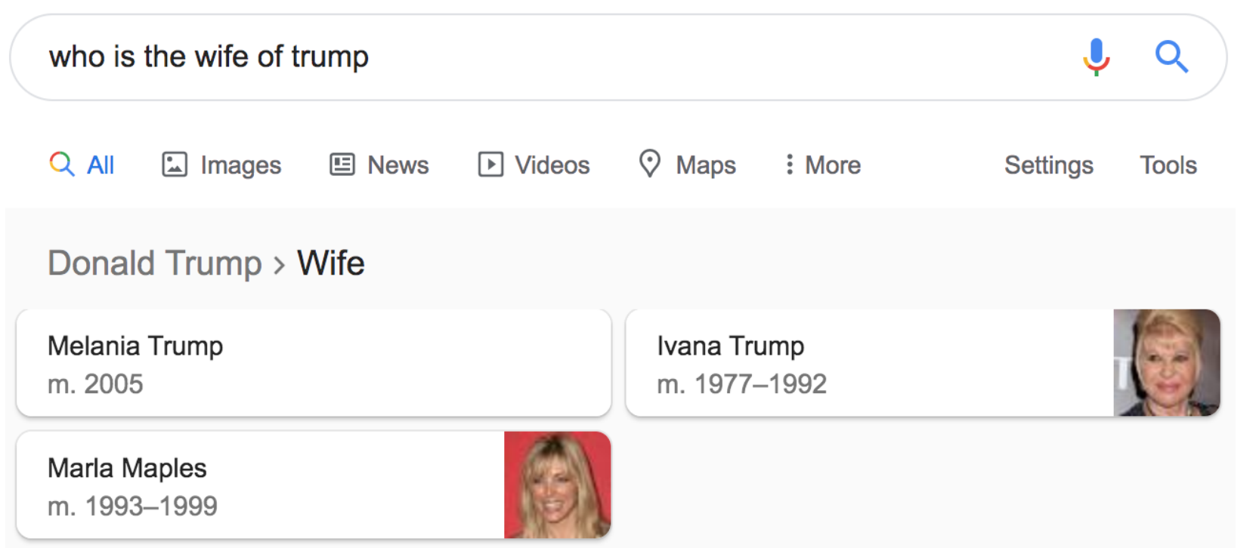
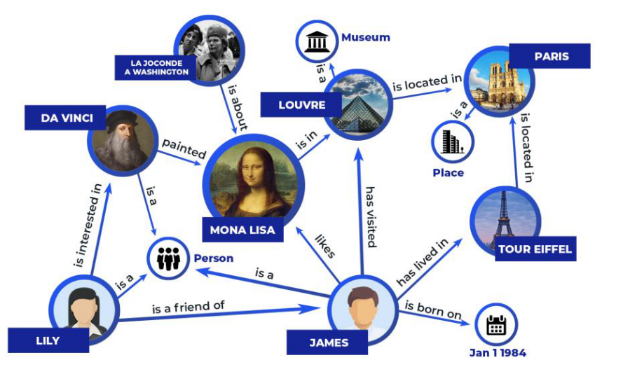
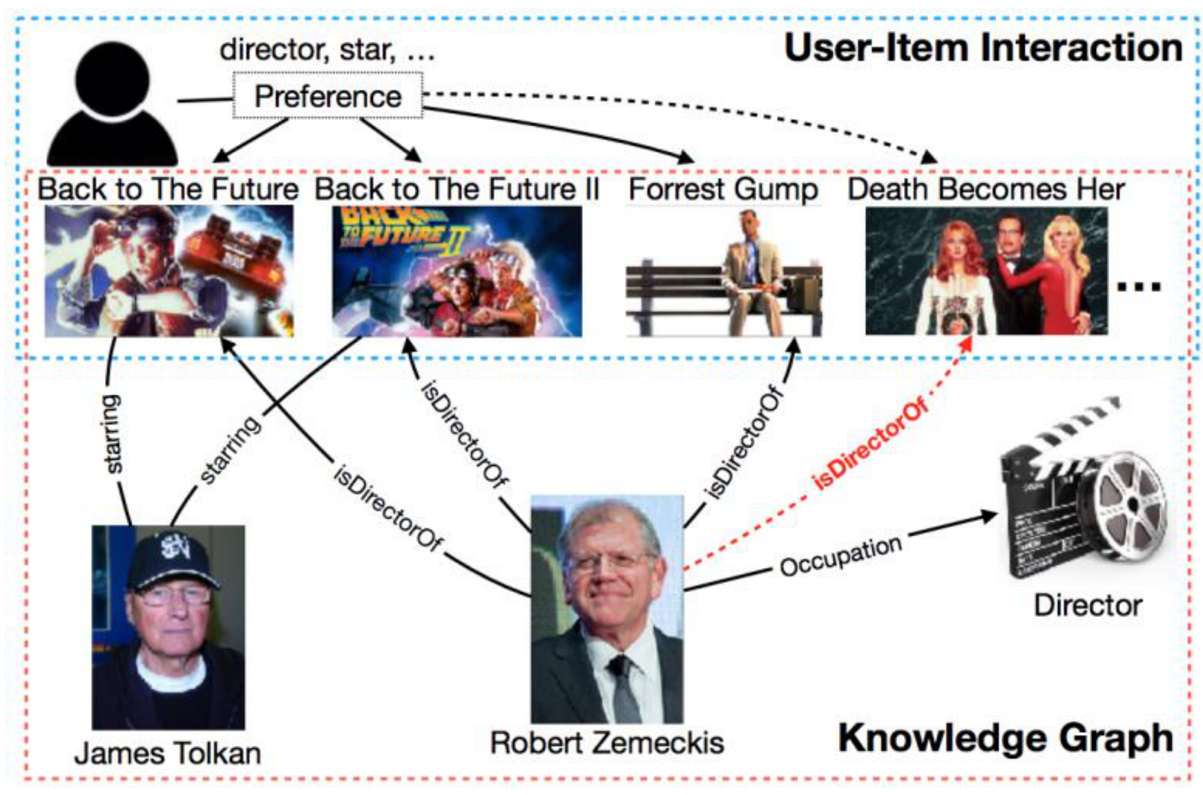
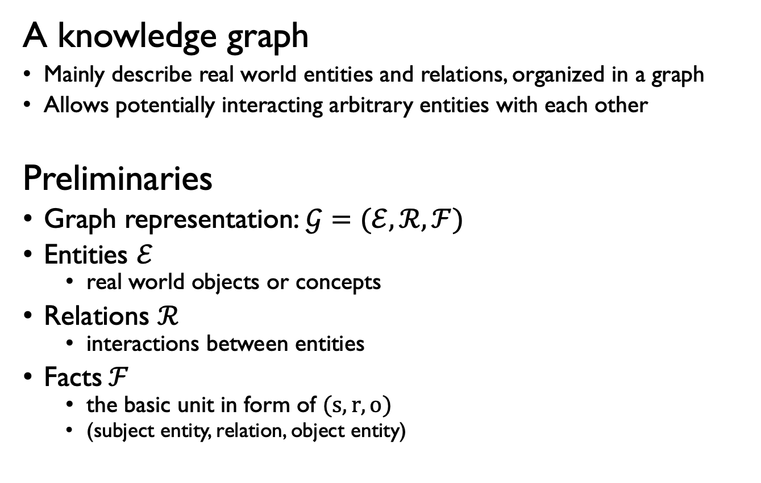
Background
A knowledge graph
Mainly describe real world entities and relations, organized in a graph
Allows potentially interacting arbitrary entities with each other
Preliminaries
Graph representation:$𝒢=(ℰ, ℛ, ℱ)$
Entities $ℰ$
real world objects or concepts
Relations $ℛ$
interactions between entities
Facts$ℱ$
the basic unit in form of $(s,r,o)$
(subject entity, relation, object entity)
Applications
KGQA:
Recommendation:

Slide 4
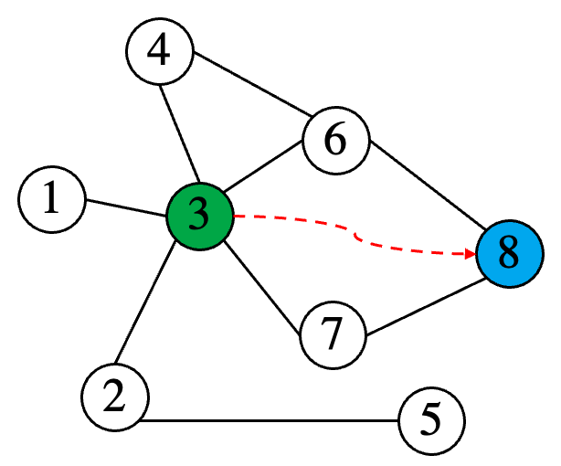
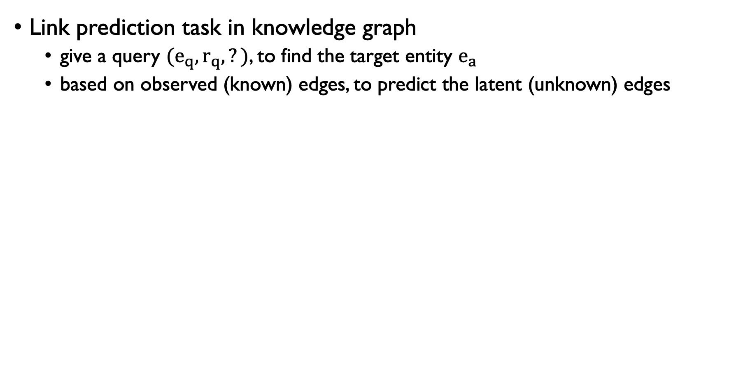
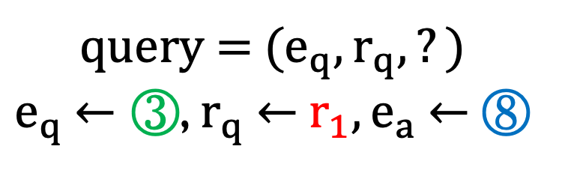
Background
Link prediction task in knowledge graph
give a query ${(e}_{q},r_{q},?)$, to find the target entity $e_{a}$
based on observed (known) edges, to predict the latent (unknown) edges
query = ${(e}_{q},r_{q},?)$
$e_{q}$ $←$ ③, $r_{q}$ $←$ $r_{1},e_{a}$ $←$ ⑧
KG

Slide 5
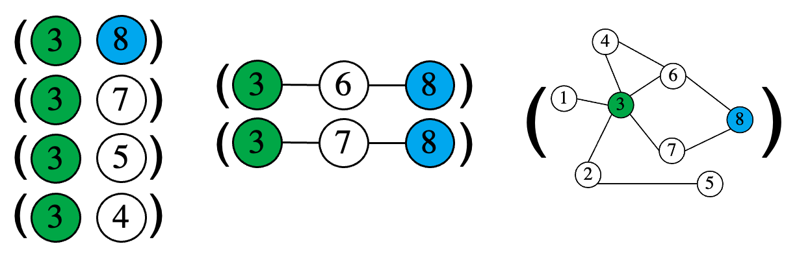
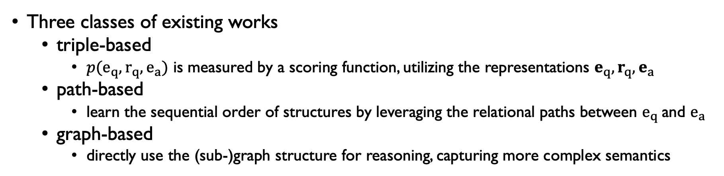
Background
Three classes of existing works
triple-based
${p(e}_{q},r_{q},e_{a})$ is measured by a scoring function, utilizing the representations $e_{q},r_{q},e_{a}$
path-based
learn the sequential order of structures by leveraging the relational paths between $e_{q}$and $e_{a}$
graph-based
directly use the (sub-)graph structure for reasoning, capturing more complex semantics
triple-based path-based graph-based
→[0,1]

Slide 6
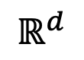
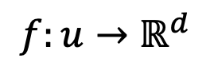
Background
Graph-based method for link prediction
Goal: efficient task-independent representations for reasoning on KG.
node
vector
encode
u
$$f:u→ℝ^{d}$$
$$ℝ^{d}$$
node representation
Reference: Representation Learning on Networks, snap.stanford.edu/proj/embeddings-www, WWW 2018

Slide 7
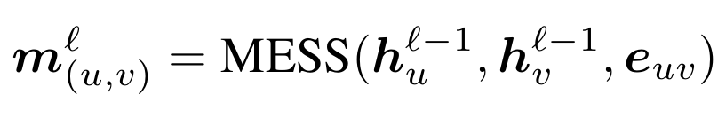
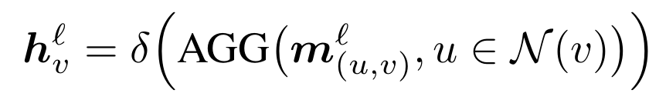
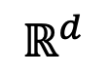
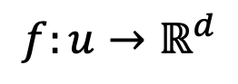
Background
Graph-based method for link prediction
Goal: efficient task-independent representations for reasoning on KG.
encode
node
vector
u
$$ℝ^{d}$$
$$f:u→ℝ^{d}$$
node representation

Slide 8
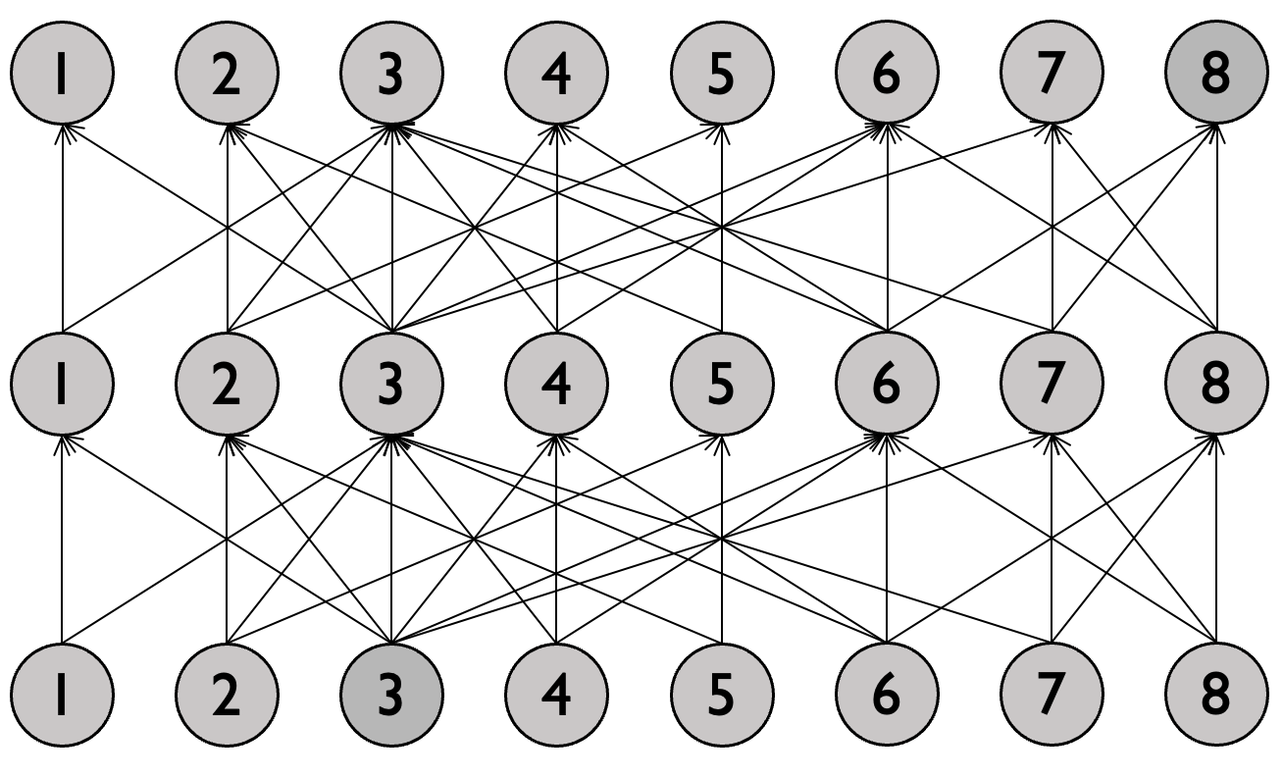
Background
Graph-based method for link prediction
propagate the message with the KG structure
update entity representation at each propagation step
forward
inference
backward
optimization
KG
Expanded ‘‘propagation path’’
step 2
Graph neural network
step 1
step 0

Slide 9
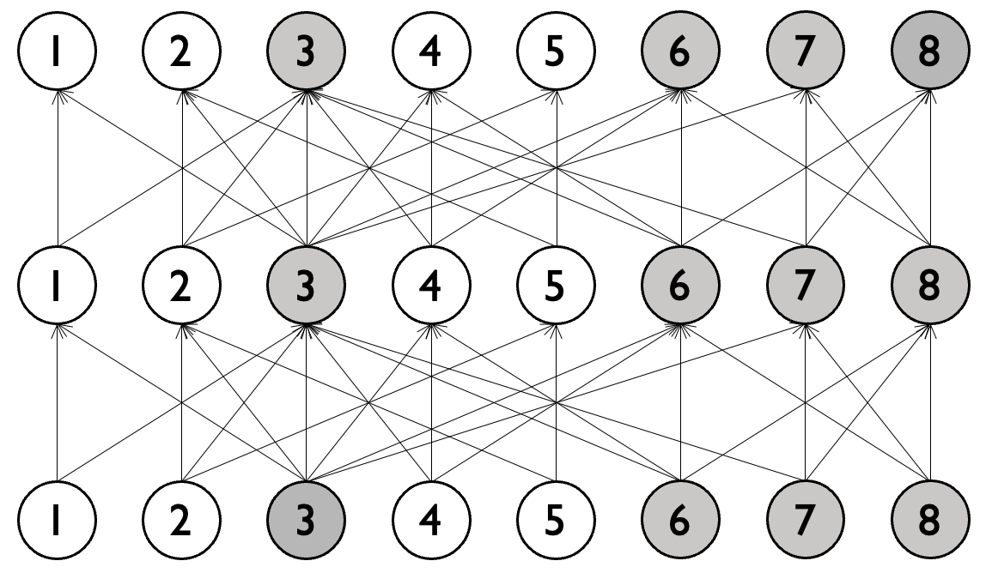
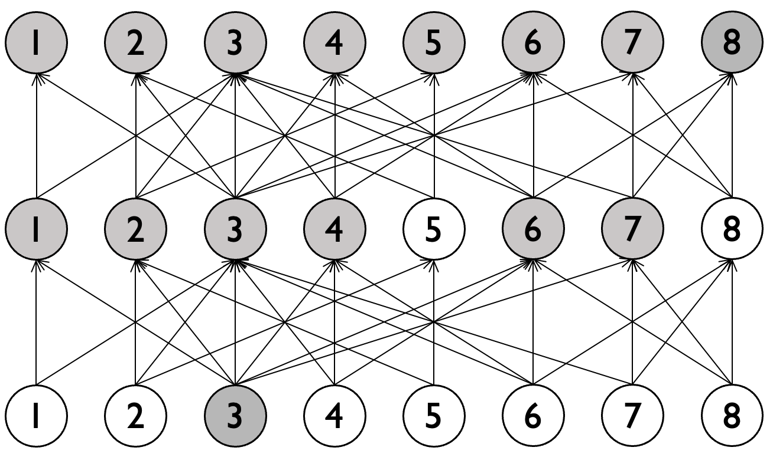
Background
Different GNNs and their ‘‘propagation paths’’
Standard
Variants
CompGCN / R-GCN
GraIL RED-GNN

Slide 10
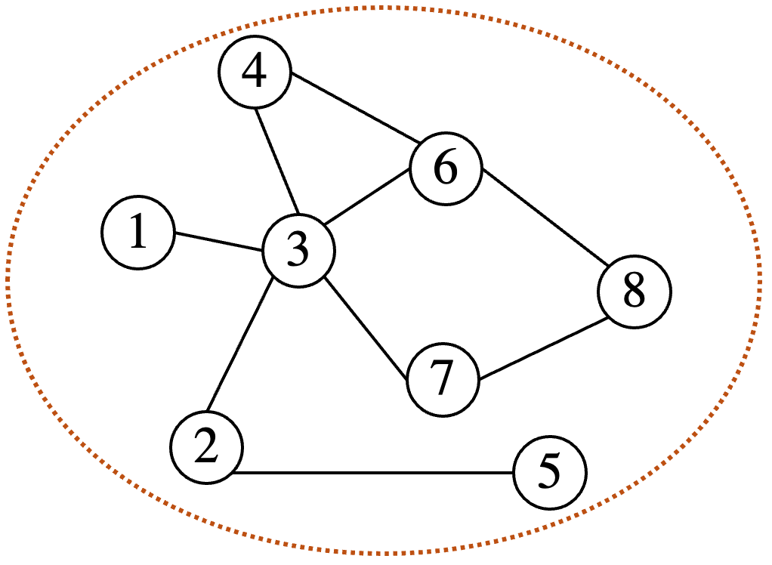
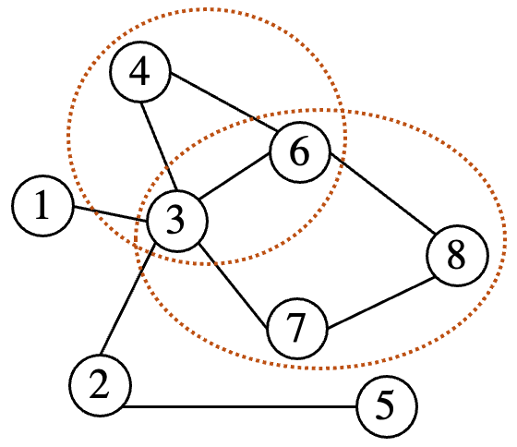
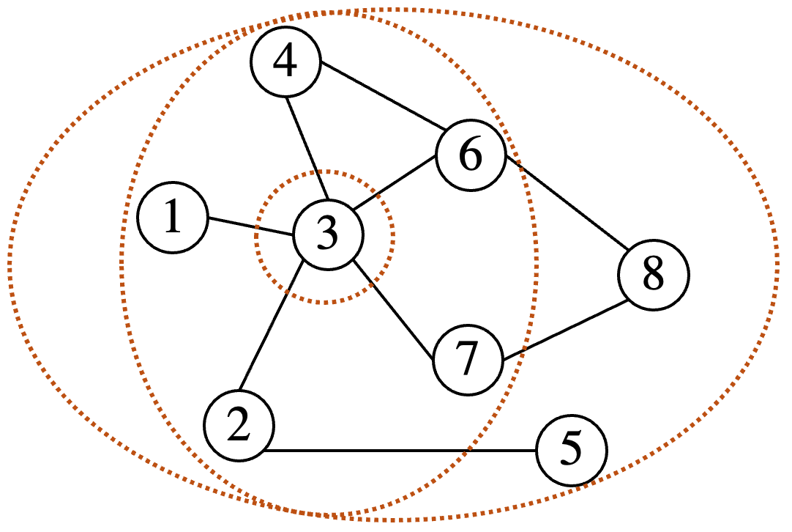
Background
R-GCN
2017
CompGCN
2020
DPMPN
2020
NBFNet
2021
2020
GraIL
2021
RED-GNN

Slide 11
Background
Existing work designed various propagation schemes.
We make formal definition and detailed analysis
to better disentangle the factors of the “propagation path”.

Slide 12
Outline
Background
A unified framework of propagation path
➔ Q₁ What is the propagation path?
Learning to propagate for KG reasoning
Summary

Slide 13
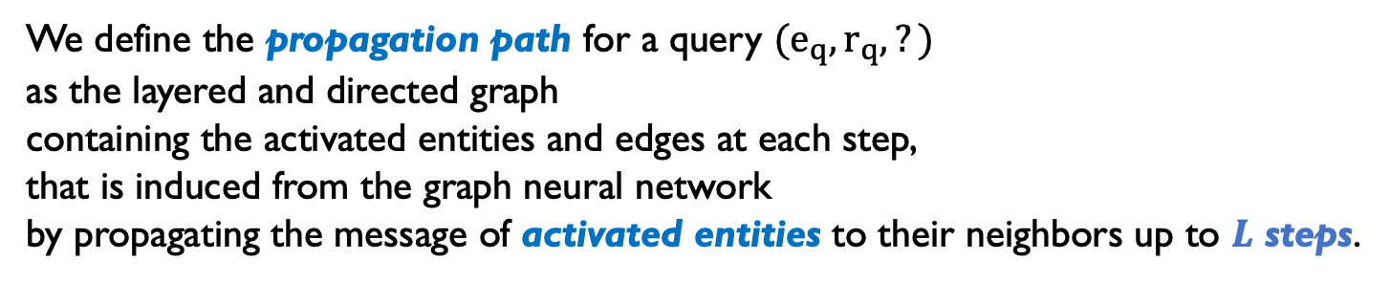
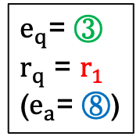
Definition of propagation path
We define the propagation path for a query $(e_{q},r_{q},?)$
as the layered and directed graph
containing the activated entities and edges at each step,
that is induced from the graph neural network
by propagating the message of activated entities to their neighbors up to $L$ steps.
example1
example2
$e_{q}$= ③
$r_{q}$ = $r_{1}$
($e_{a}$= ⑧)
step 2
step 1
step 0
Activated entity
Inactivated entity

Slide 14

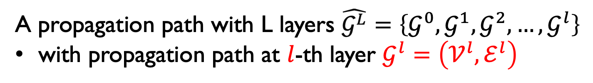
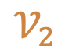
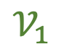

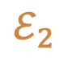
Definition of propagation path
A propagation path with L layers $\hat{𝒢^{L}}=\left\{𝒢^{0},𝒢^{1},𝒢^{2},…,𝒢^{l}\right\}$
with propagation path at $l$-th layer $𝒢^{l}=\left(𝒱^{l},ℰ^{l}\right)$
propagation path example1
propagation path example2
step 2
$$𝒱_{2}$$
$$ℰ_{2}$$
step 1
$$𝒱_{1}$$
$$ℰ_{1}$$
step 0
$$𝒱_{0}$$
Activated entity
Inactivated entity

Slide 15
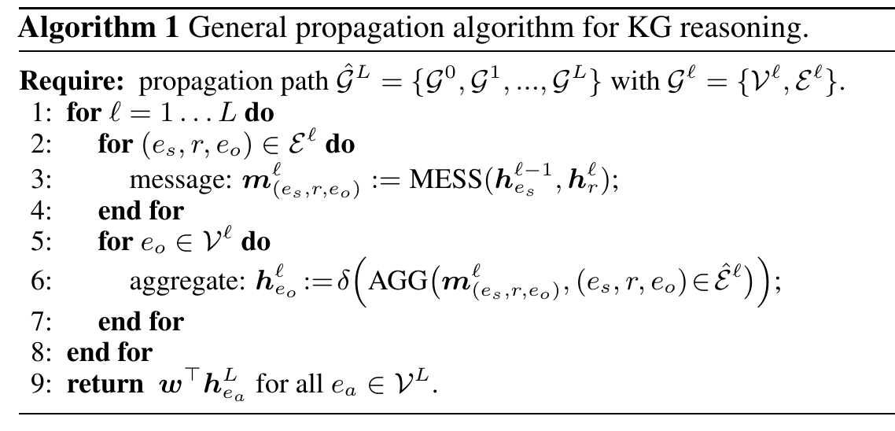
A unified learning framework based on the propagation path
What we focus on
message passing
message aggregation
readout
Detailed comparison can be found in Appendix

Slide 16
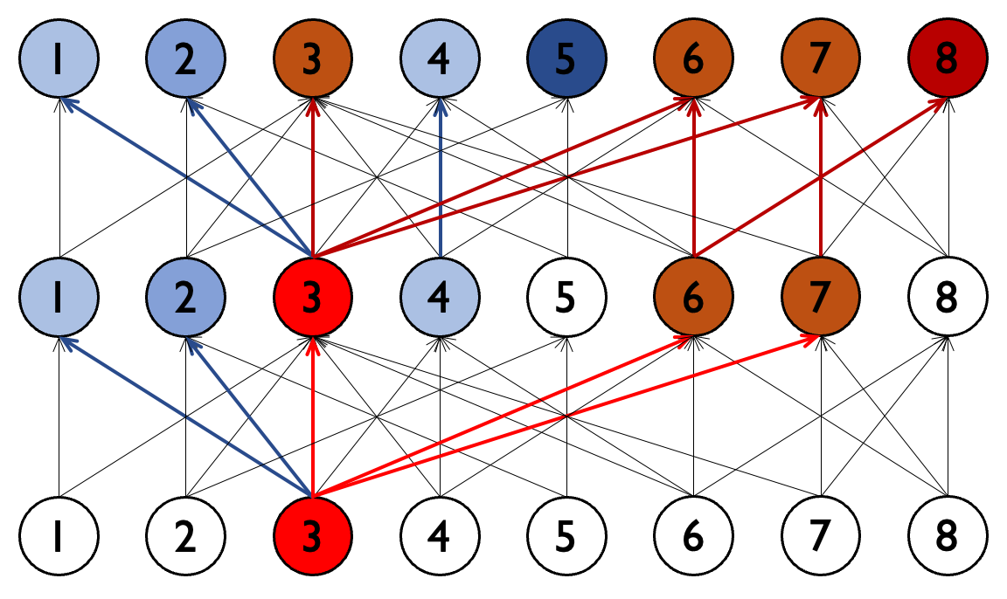
Properties of propagation path
Range (structural property)
breadth / depth / size
Relevance w.r.t. the query (semantic property)
weights of entities and edges
Breadth: number of activated entities
Depth:
maximum
propagation
steps

Slide 17
Taxonomy | w.r.t. Range
Full propagation
CompGCN / R-GCN
NBFNet / DPMPN
Limited propagation
GraIL
Progressive propagation
RED-GNN

Slide 18
Taxonomy | w.r.t. Relevance
Query-dependent
RED-GNN / NBFNet
DPMPN /GraIL
Not query-dependent
R-GCN / CompGCN

Slide 19
Comparison of existing works
Semantic
Query-dependent
Not query-dependent
Full
propagation
NBFNet
DPMPN
R-GCN
CompGCN
Structural
Limited
propagation
GraIL
NA
Progressive
propagation
RED-GNN
NA

Slide 20
Comparison of existing works
Semantic
Query-dependent is better than not query-dependent
Full
propagation
NBFNet
DPMPN
R-GCN
CompGCN
Structural
Limited
propagation
GraIL
NA
Progressive
propagation
RED-GNN
NA

Slide 21
Comparison of existing works
Structural
Full
propagation
NBFNet
DPMPN
Too expensive.
Hard to propagate deeper.
Limited
propagation
GraIL
Progressive
propagation
RED-GNN

Slide 22
Comparison of existing works
Structural
Full
propagation
NBFNet
DPMPN
Limited
propagation
Requires query entity and answer entity.
Extracting enclosing subgraphs is inefficient.
GraIL
Progressive
propagation
RED-GNN

Slide 23
Comparison of existing works
Structural
Full
propagation
NBFNet
DPMPN
WN18RR
Limited
propagation
GraIL
Progressive
propagation
RED-GNN
FB15k-237
Will degenerate to the full propagation.
Suffer in a dense graph.

Slide 24
Comparison of existing works
Query-dependent
Not query-dependent
Full
propagation
Too expensive.
Hard to propagate deeper.
Large size but shallow step.
Expensive and inefficient.
Requires query entity and answer entity.
Extracting enclosing subgraphs is inefficient.
Inapplicable for large graph.
Limited
propagation
Progressive
propagation
Will degenerate to the full propagation.
Suffer in a dense graph.

Slide 25
Outline
Background
A unified framework of propagation path
➔ Q₁ What is the propagation path?
➔ Q₂ What kinds of propagation paths do we need?
Learning to propagate for KG reasoning
Summary

Slide 26
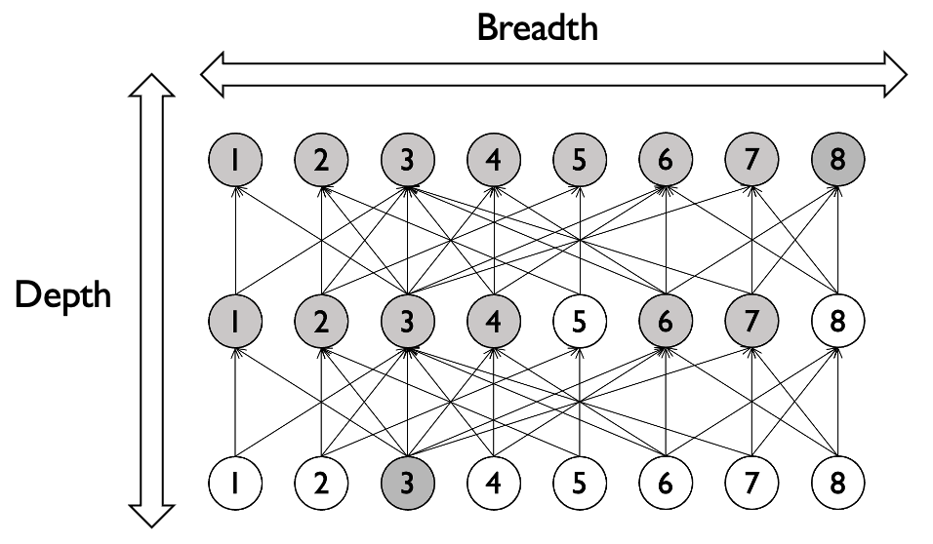
Motivations
Q₂: what kinds of propagation paths do we need? 🤔
Deeper step ➔ to capture longer-range semantics
Smaller size ➔ to decrease complexity and cost
Query-dependent ➔ to distinguish different entities and edges
Structural
Semantic

Slide 27
Motivations
Q₂: what kinds of propagation paths do we need? 🤔
Deeper step ➔ to capture longer-range semantics
Smaller size ➔ to decrease complexity and cost
Query-dependent ➔ to distinguish different entities and edges
Structural
Semantic
Give max propagation size,
lower breadth ➔ higher depth
Full propagation
Depth
Breadth (no. activated entities)

Slide 28
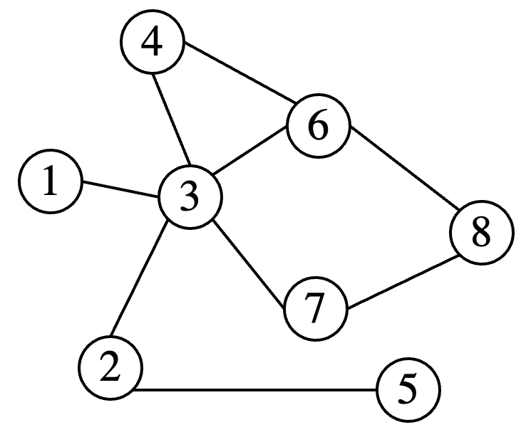
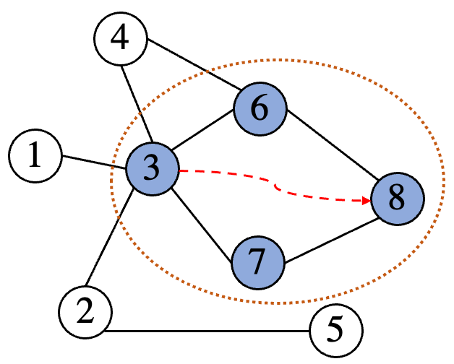
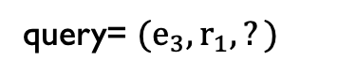
Motivations
Q₂: what kinds of propagation paths do we need?
The expected breadth
query= $(e_{3},r_{1},?)$

Slide 29
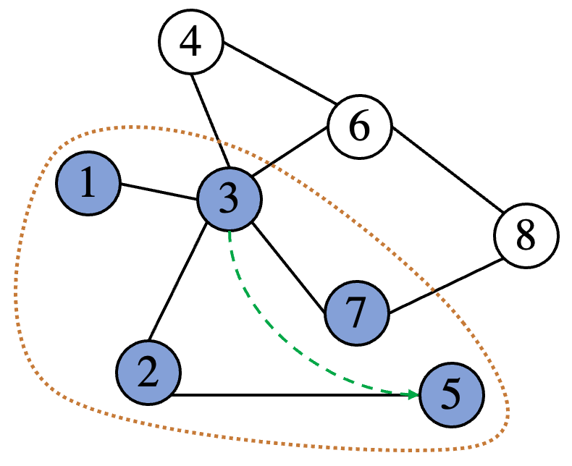
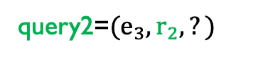
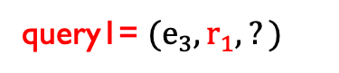
Motivations
The expected breadth
Q₂: what kinds of propagation paths do we need?
query1= $(e_{3},r_{1},?)$
query2=$(e_{3},r_{2},?)$

Slide 30
Outline
Background
A unified framework of propagation path
➔ Q₁ What is the propagation path?
➔ Q₂ What kinds of propagation paths do we need?
Learning to propagate for KG reasoning
➔ Q₃ How to learn the expected propagation paths?
Summary

Slide 31
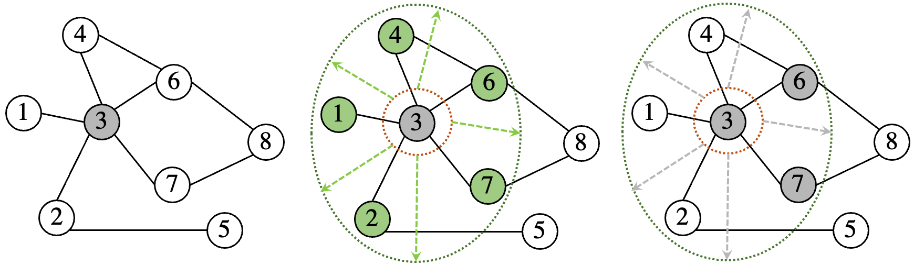
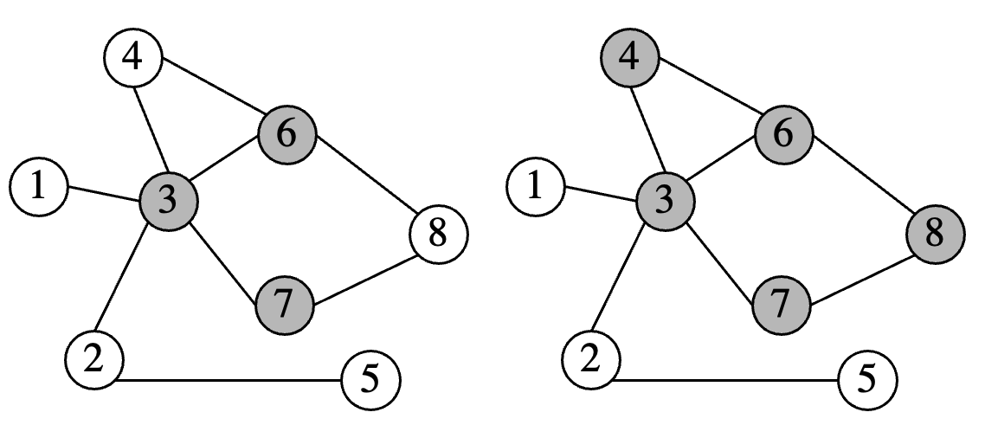
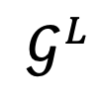
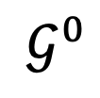
Overview
Q_{3.} How to learn the expected propagation paths?
❔
$$𝒢^{0}$$
$$𝒢^{L}$$

Slide 32
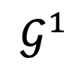
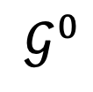
Overview
To sample the “good” entities and discard the “bad” ones in each propagation step.
$$𝒢^{0}$$
Propagate with sampling
sampled entities are activated
discarded entities stay inactivated
$$𝒢^{1}$$
Activated entity
New-visit entity
Inactivated entity

Slide 33
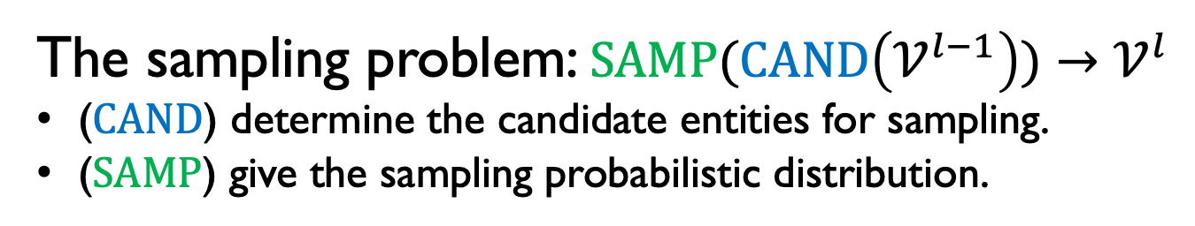
Sampling scheme
Activated entity
New-visit entity
Inactivated entity
The sampling problem: $SAMP(CAND\left(𝒱_{ }^{l−1}\right))$ $→𝒱_{ }^{l}$
($CAND$) determine the candidate entities for sampling.
($SAMP$) give the sampling probabilistic distribution.

Slide 34
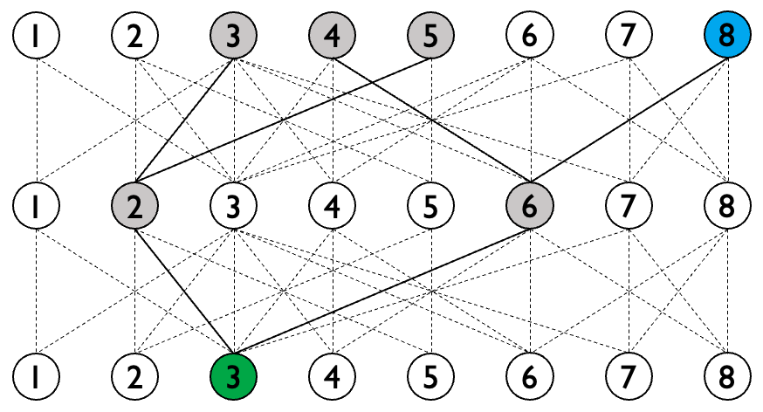
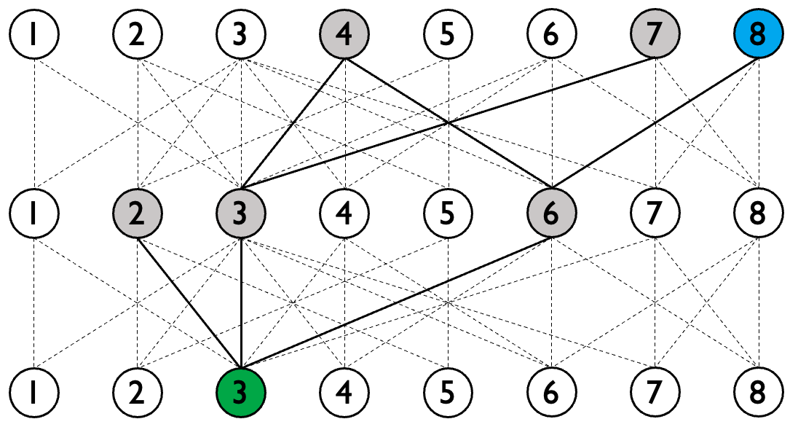
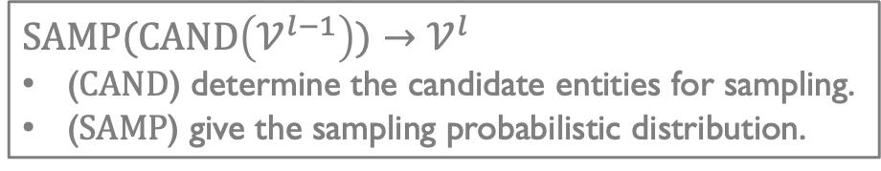

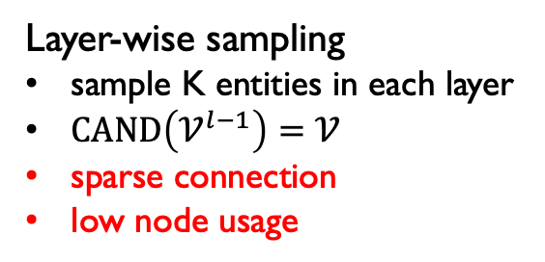
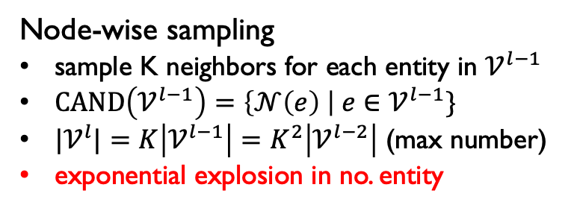
Sampling scheme | $CAND$
$SAMP(CAND\left(𝒱_{ }^{l−1}\right))$ $→𝒱_{ }^{l}$
($CAND$) determine the candidate entities for sampling.
($SAMP$) give the sampling probabilistic distribution.
Node-wise sampling
sample K neighbors for each entity in $𝒱_{ }^{l−1}$
$CAND\left(𝒱_{ }^{l−1}\right)=\left\{𝒩\left(e\right) \right| e∈𝒱_{ }^{l−1}\}$
${|𝒱}_{ }^{l}|=K\left|𝒱_{ }^{l−1}\right|=$ $K^{2}\left|𝒱_{ }^{l−2}\right|$ (max number)
exponential explosion in no. entity
Layer-wise sampling
sample K entities in each layer
$CAND\left(𝒱_{ }^{l−1}\right)=𝒱$
sparse connection
low node usage
Node-wise, K=2
Layer-wise, K=3

Slide 35
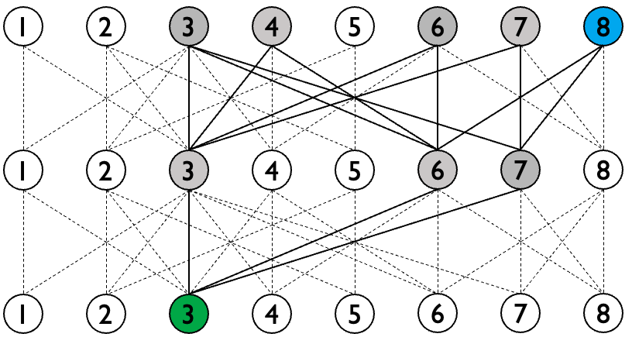
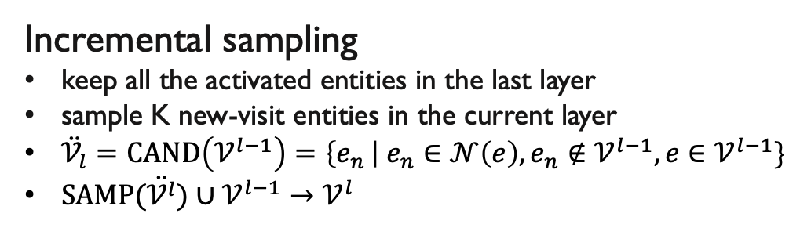
Sampling scheme | $CAND$
$SAMP(CAND\left(𝒱_{ }^{l−1}\right))$ $→𝒱_{ }^{l}$
($CAND$) determine the candidate entities for sampling.
($SAMP$) give the sampling probabilistic distribution.
Incremental sampling
keep all the activated entities in the last layer
sample K new-visit entities in the current layer
$\ddot{𝒱_{l}}=CAND\left(𝒱_{ }^{l−1}\right)=\left\{e_{n }\right| e_{n}∈𝒩{\left(e\right), e_{n}∉𝒱_{ }^{l−1}, e∈𝒱_{ }^{l−1}\}}_{ }$
$SAMP(\ddot{𝒱_{ }^{l}})∪𝒱_{ }^{l−1}→𝒱_{ }^{l}$
Incremental, K=2

Slide 36


Sampling scheme | $CAND$
$SAMP(CAND\left(𝒱_{ }^{l−1}\right))$ $→𝒱_{ }^{l}$
($CAND$) determine the candidate entities for sampling.
($SAMP$) give the sampling probabilistic distribution.
Node-wise sampling
sample K neighbors for each entity in$𝒱_{ }^{l−1}$
exponential explosion in no. entity
✅ Increase speed can be directly controlled by K
Incremental sampling
keep all the activated entities in the last layer
sample K new-visit entities in the current layer
Layer-wise sampling
sample K entities in each layer
sparse connection, low entity usage
✅ Every entity in${ 𝒱}_{ }^{l−1}$is connected to $𝒱_{ }^{l}$

Slide 37



Sampling scheme | $SAMP$
$SAMP(CAND\left(𝒱_{ }^{l−1}\right))$ $→𝒱_{ }^{l}$
($CAND$) determine the candidate entities for sampling.
($SAMP$) give the sampling probabilistic distribution.
➔ How to sample K entities from the candidate set $\overline{𝒱_{l}}$

Slide 38



Sampling scheme | $SAMP$
$SAMP(CAND\left(𝒱_{ }^{l−1}\right))$ $→𝒱_{ }^{l}$
($CAND$) determine the candidate entities for sampling.
($SAMP$) give the sampling probabilistic distribution.
Standard categorical distribution:
Given $n$ logits $\left[φ_{1}, φ_{2},…,φ_{n}\right],$ and a sampling distribution $p_{i}=\frac{\exp{(φ_{i})}}{\sum_{j=1}^{n}{\exp{(φ_{j})}}}$
The Gumbel softmax trick:
add the noise $u_{i}∼U\left(0,1\right)$to the logits with $φ_{i}^{′}=φ_{i}−\log\left(−\log{u_{i}} \right)$
get top-k $φ_{i}^{′}$ is an approximation of sampling from $p_{i}^{′}=\frac{\exp{(φ_{i}^{′}/τ)}}{\sum_{j=1}^{n}{\exp{(φ_{j}^{′}/τ)}}}$

Slide 39

Sampling scheme | Optimization
Straight through gradient estimator
➔ multiply the sampling logits to the corresponding entity representations
$$φ_{e_{i}}←σ(W_{samp}^{l}h_{e_{i}}^{l})$$
$$p^{l}\left(e_{i}\right)←{\text{Gumbel}\text{_}\text{softmax} \text{(}φ}_{e_{i}} | \{φ_{e_{j}},e_{j}∈\ddot{𝒱_{l}}\})$$
$h_{e_{i}}^{l} ←h_{e_{i}}^{l}∗(1−no_grad(p^{l}\left(e_{i}\right))+p^{l}\left(e_{i}\right))$

Slide 40



Full algorithm
$$CAND$$
Message propagation
$$SAMP$$
Optimization

Slide 41





Full algorithm
Propagate with sampling
$$𝒢^{0}$$
$$𝒢^{1}$$
$$𝒢^{1}$$
$$𝒢^{2}$$

Slide 42
Outline
Background
➔ Q₁ What is the propagation path?
A unified framework of propagation path
➔ Q₂ What kinds of propagation paths do we need?
Learning to propagate for KG reasoning
➔ Q₃ How to learn the expected propagation paths?
Summary

Slide 43
Summary
Three problems to study
Three major contributions
Q₁ What is the propagation path.
Q₂ What kinds of propagation paths do we need.
Q₃ How to learn the expected propagation paths.
A unified framework of propagation path of GNN models for KG reasoning.
A novel GNN with incremental sampling strategy that can learn query-dependent propagation path.
The state-of-the-arts performance in both transductive and inductive reasoning settings.

Slide 44
Q&A
Thanks for your attention!

Slide 45
Appendix

Slide 46


A unified learning framework based on the propagation path
Model | Year | $$𝒱_{0}$$ | $$𝒱_{l}$$ | $$ℰ_{1}$$ | $$ℰ_{l}$$
R-GCN | 2017 | $$𝒱$$ | $$𝒱$$ | $$ℰ$$ | $$ℰ$$
CompGCN | 2020 | $$𝒱$$ | $$𝒱$$ | $$ℰ$$ | $$ℰ$$
GraIL | 2020 | $$𝒱_{s}⊆𝒱$$ | $$𝒱_{s}⊆𝒱$$ | $$ℰ_{s}⊆ℰ$$ | $$ℰ_{s}⊆ℰ$$
NBFNet | 2021 | $$𝒱$$ | $$𝒱$$ | $$ℰ$$ | $$ℰ$$
RED-GNN | 2021 | $${\{e}_{q}\}$$ | $${\{e}_{o}|\left(e_{s},r,e_{o}\right)∈ℰ_{l}\}$$ | $$\{\left(e_{q},r,e_{o}\right)∈ℰ\}$$ | $$\{\left(e_{s},r,e_{o}\right)∈ℰ|e_{s}∈𝒱_{l−1}\}$$
Model | MESS( ) $→m_{ }^{l}$ | AGG( ) ${→h}_{e_{o}}^{l}$ | Complexity
R-GCN | $${W^{l}h}_{e_{s}}^{l−1}$$ | $$σ({∑m}_{e_{o}}^{l}+W_{0}^{l}h_{e_{o}}^{l−1})$$ | $$L|𝒱|$$
CompGCN | $$W^{l}φ(h_{e_{s}}^{l−1},h_{r}^{l})$$ | $$σ(∑m_{e_{o}}^{l}+W_{0}^{l}h_{e_{o}}^{l−1})$$ | $$L|𝒱|$$
GraIL | $$W^{l}φ(h_{e_{s}}^{l−1},h_{r}^{l},h_{r_{q}}^{l})$$ | $$σ(∑m_{e_{o}}^{l}+W_{0}^{l}h_{e_{o}}^{l−1})$$ | $$L|𝒱_{s}|$$
NBFNet | $$W_{r_{q}}^{ }φ(h_{e_{s}}^{l−1},h_{r}^{l})$$ | $$σ(W^{l}(∑m_{e_{o}}^{l},h_{e_{o}}^{0}))$$ | $$L|𝒱|$$
RED-GNN | $$W^{l}φ(h_{e_{s}}^{l−1},h_{r}^{l},h_{r_{q}}^{l})$$ | $$σ({W^{l}∑m}_{e_{o}}^{l})$$ | $\sum_{i=1}^{L}{|𝒱_{i}|}$

Slide 47



Background – Knowledge Graph Embedding (KGE)
Knowledge Graph Embedding
Encode entities and relations in KG into low-dimensional vectors space
while capturing nodes’ and edges’ connection properties
Most KGE models based on embeddings define a scoring function $F$ to estimate the plausibility of any fact $(s,r,o)$ using their embeddings:
vectorize
entities & relations
$$F\left(s,r,o\right)=p\left(o | s,r\right) or p\left(s | o,r\right) or p(r|s,o)$$

Slide 48



Background – review of KGE models
Simple Taxonomy
Embedding models
tensor decomposition models
geometric models
deep learning models
Structure-based models
rule-mining
path/graph-based
$$F(s,r,o)$$

Slide 49





KGE training and testing
Training
$S^{+}:positive samples S^{−}:negative samples$
Objectives: $\max{φ^{+}(S^{+}) }$+ $φ^{−}(S^{−})$
Prediction
For link prediction, given an incomplete triple $(h, r,?)$
the missing tail is inferred as the entity that results in the highest score:
Evaluation
Three common metrics
q: the rank of correct entity

Slide 50


Background – Knowledge Graph Embedding (KGE)
Transductive learning | Popular learning paradigm in KGE
Training data
Testing data
Query (s,r,o)?
transductive
setting
The same set of entities (nodes)
for the training and testing data

Slide 51

Two learning paradigms: Inductive and transductive
Training data
Testing data
The same set of entities (nodes) as the training data
transductive
Inductive
Different set of entities to the training data
e.g.,
﻿new users and products on e-commerce platforms
new molecules in biomedical KG
No matching node

